Slide 1
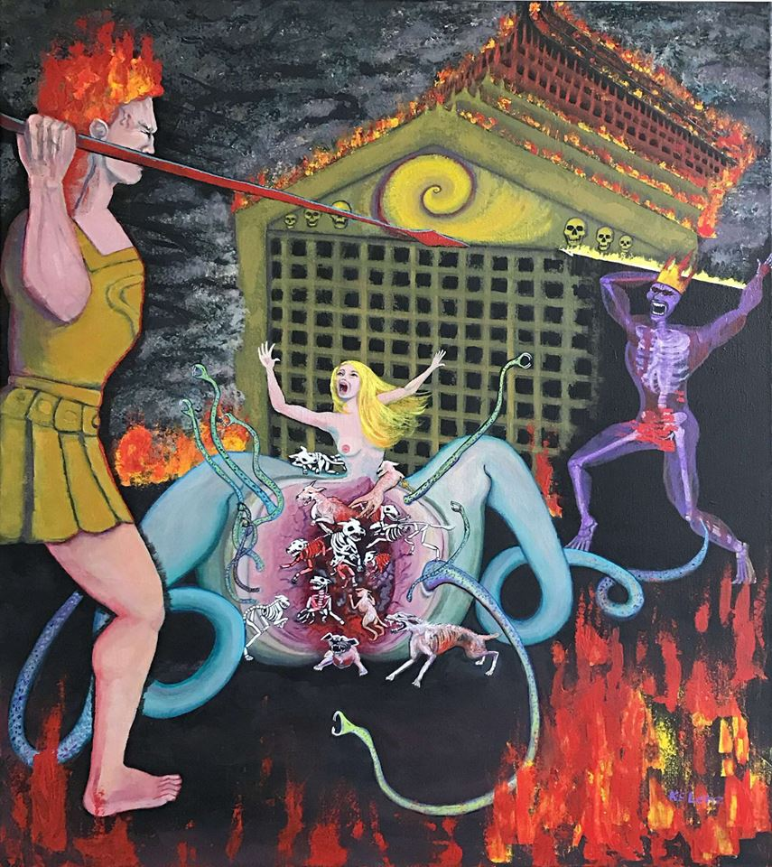
Violated and Rebellious:
Women and Nature in John Milton’s
Paradise Lost
Katelyn Gill

Slide 2
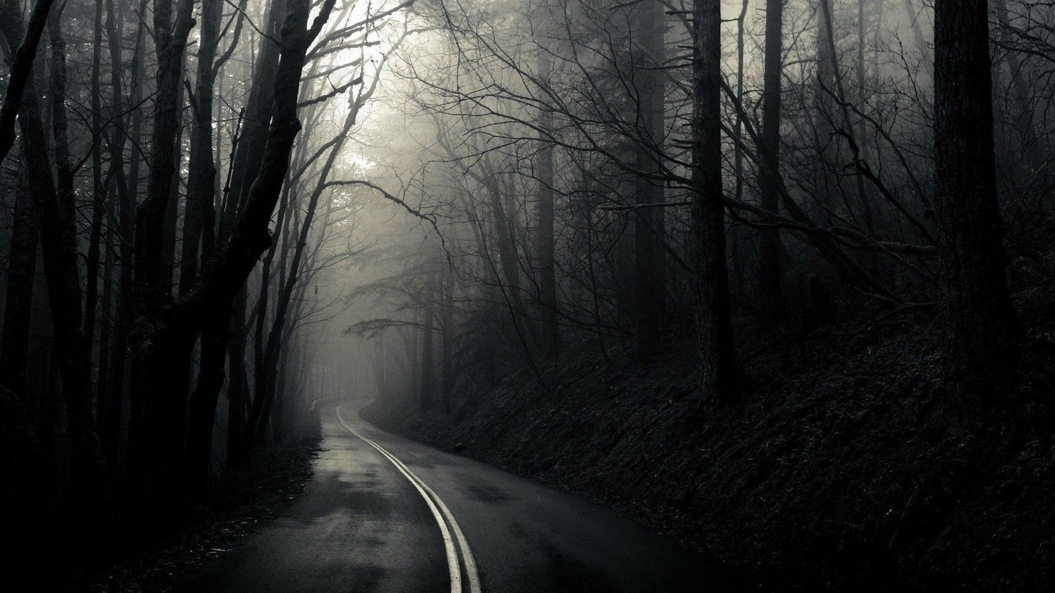
The Loneliest Road
Monomythic Narrative in Robert Browning’s “Childe Roland to the Dark Tower Came” and Cormac McCarthy’s The Road

Slide 3
Traumatic Memories of Sexual Assault in The Perks of Being a Wallflower and The Bluest Eye
By: Jessica S. Landers

Slide 4
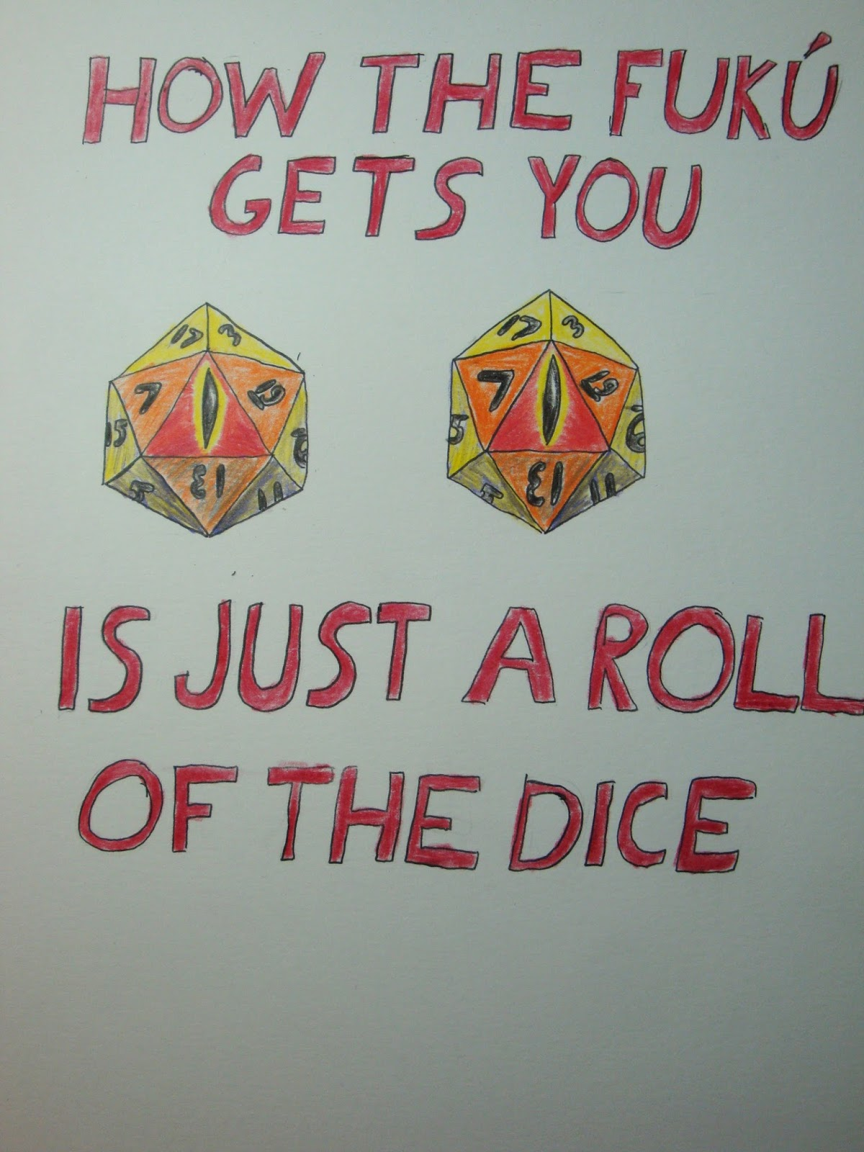
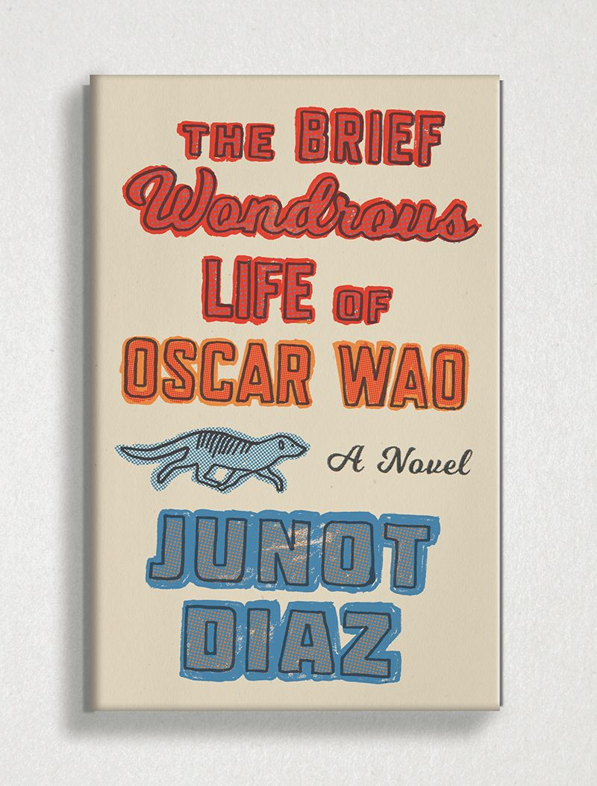
Dominican Despair and Hope in
The Brief Wondrous
Life of Oscar Wao
By Charles X. Rodriguez

Slide 5
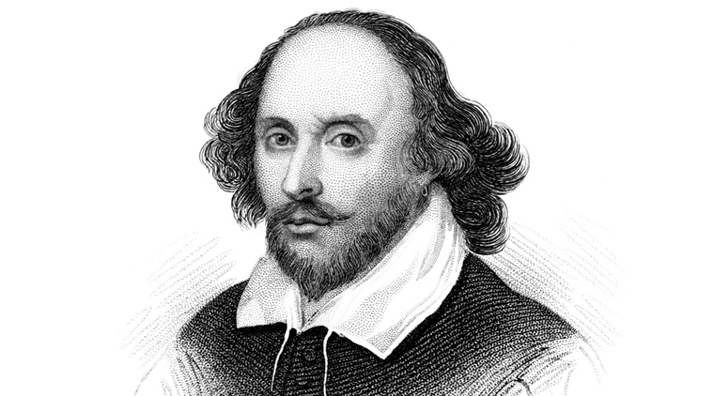
The Bed Trick’s Problematic Role in Shakespeare’s
All’s Well That Ends Well and Measure for Measure
By Maritza Gonzalez

Slide 6

Donald Barthelme, Margaret Atwood, and Julio Cortázar: The Short Story Genre’s Facilitation of Postmodernism
By: Skylar Harsson

Slide 7
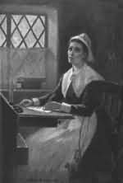
The Enigma of
Anne Bradstreet
By Emily Bush
“Let such as say our sex is void of reason,
Know it is slander now but once was treason.”
― Anne Bradstreet
“If ever two were one, then surely we. If ever man were loved by wife, then thee.”
― Anne Bradstreet

